Slide 1
TLC quantum PROGRESS Meeting
Fontys

Slide 2
Agenda
Recap
Goals Sprint 3
Finished Goals
Documents
Demo
Action points
Sprint 4 goals
New Action Point

Slide 3
Recap goals
Sprint Goals Planned
Documentation:
U-N014: Security Report
U-N015: Cost analysis
U-N016: Data and Law (GDPR)
U-N017: Cloud Research
Website:
U-E016: Select Available Tournament
U-E033: Access Tournament Information
U-A001: Create a tournament
U-A002: Edit a tournament
U-A003: View a tournament
U-A004: View all tournaments
U-A005: Delete a tournament

Slide 4
Recap goals
Sprint Goals Done
Documentation:
U-N014: Security Report
U-N015: Cost analysis
U-N017: Cloud Research
Website :
U-E016: Select Available Tournament
U-E033: Access Tournament Information
U-A001: Create a tournament
U-A002: Edit a tournament
U-A003: View a tournament
U-A004: View all tournaments
U-A005: Delete a tournament

Slide 5
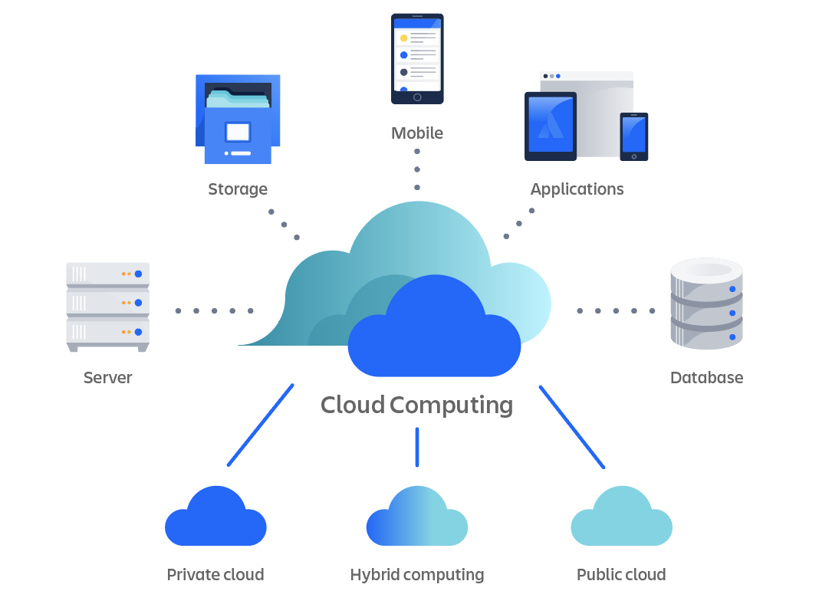
Cloud Research
Password Storage
Deployment

Slide 6
Cost Analysis
Azure
300 euros per month

Slide 7
Security Report
Key points
Password Security
Authentication and Authorization
Data Protection
Data Input and Output
Cheating

Slide 8
Demo

Slide 9
Action points
TLC Quantum Progress Meeting
Prioritize making the website work for the first demo
Tic-Tac-Toe Tournament Implementation

Slide 10
Goals for sprint 4
Next Sprint Goals
Website:
U-E034: Start Game
U-E023: View Leaderboard
U-E037: Challenge User
U-E038: Accept Challenge
Next Progress Meeting: June 6th

Slide 11
Goals for sprint 4
Next Sprint Goals
Research
U-N016: Data and Law (GDPR)
U-N018: User Friendly Research
Next Progress Meeting: June 6th

Slide 12
New Action points
Azure Account

Slide 13
Thank You

